Slide 2
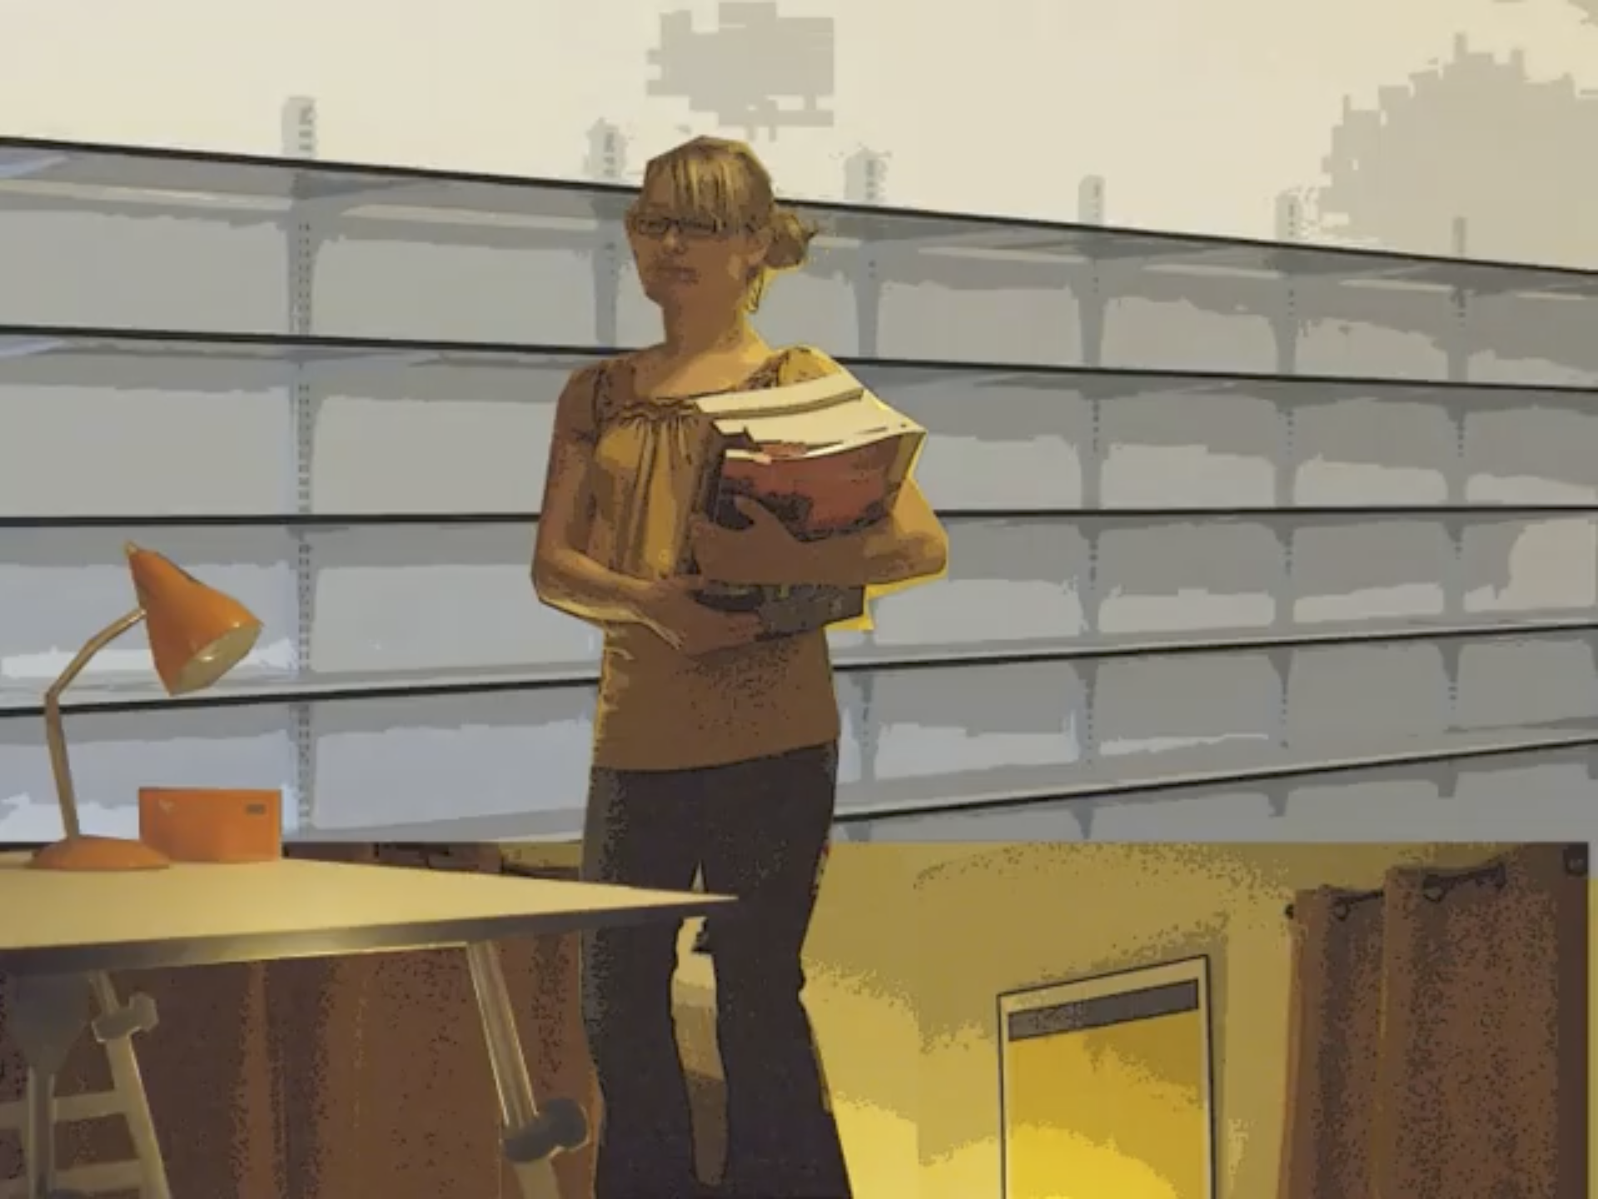
Connection to chapter 1:
A bedroom transforms into a workspace autonomously, whereby the system captures human activity (pattern recognition – “input 3” in the diagram of my previous slide) and translates this input into the physical actuation of the furnishings (“scene 3”).
1
Link to GIF:
Other GIFs for inspiration: 2, 3, 4, 5, 6

Slide 3
Questions following from chapter 1
Theme: form factor, scale, interaction mode:
How do we know if architectural robotics is the right form factor or physical scale for a given application? If it is “architectural robotics,” is it furniture, a distributed system of lighting, sound, and smaller physical units, or of room or building scale?
Theme: interaction mode
For a given application, how do we decide on the mode of interaction?

